Slide 1
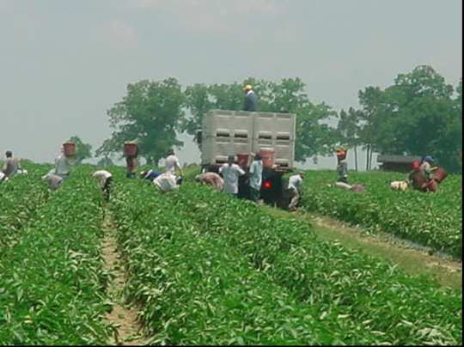
Migrant Education Program (MEP)

Slide 9
Teachers and principals should KNOW which migrant students are PFS and how best to meet their needs

Slide 12
Migrant Education Program (MEP) in Colquitt County
Approximately 650 students, 3 years old through 12th grade – in school
Approximately 130 Out-of-School Youth (OSY), 16 to 22 years old – working in fields
NOT all Hispanic students are migrant
NOT all ESOL students are migrant
Most migrant students are Hispanic
Some migrant students are English Learners (ELs)

Slide 13
Migrant Education Program (MEP) in Colquitt County
Largest migrant student population in Georgia
MEP Staff:
5 elementary tutors
1 middle tutor
1 junior high tutor
1 high school tutor
3 recruiters
2 pre-school teachers (3 yr. old pre-school classes at Funston and Odom)
2 pre-school paraprofessionals
1 part-time coordinator

Slide 14
Participant Documentation
Please sign the attendance form to document:
You know the purpose of the migrant education program.
You know who are migrant students in your school or classroom.
You know which of your migrant students are Priority for Service (PFS)

Slide 15
Thank you for your support of our migrant students !

