Slide 1
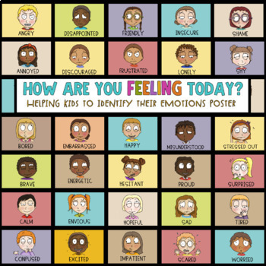
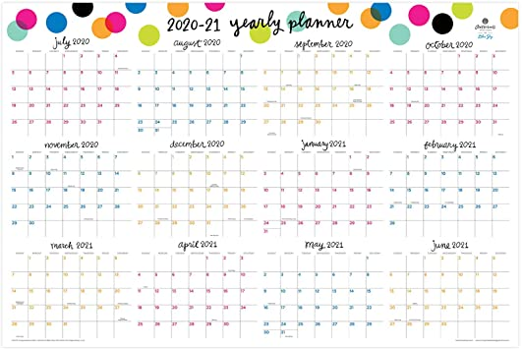
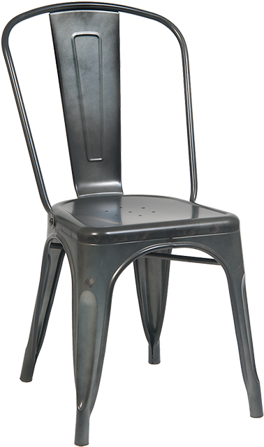
Click on the different pictures to find resources at our school and in the community.
Light/Utility/Rent Assistance
School Needs
Camps
Got Feelings?
Food
Toy

Slide 2
Families have multiple ways of securing food in our community.
DFCS- Department of Family & Children Services https://gateway.ga.gov/access/
Colquitt Co. Food Bank http://colquittfoodbank.org/
Agencies in our Community http://colquitt.gafcp.org/resources/food/
GA Dept. of Public Health https://dph.georgia.gov/WIC
USDA Find meals for Kidshttps://www.fns.usda.gov/meals4kids

Slide 3
Students have the opportunity to participate in Seasonal & Summer Camps:
Colquitt County Art Center https://colquittcountyarts.com/
Camp WindShape through Titus Ranch http://www.titusranch.org/
Grief Camp through CRMC https://colquittregional.com/about/news/Leaves-of-Love-2

Slide 4
Utility and Rent Assistance is available to families that qualify for assistance. Assistance is determined by the guidelines put in place by the agency. Check out this website to see if you qualify for assistance. Light/Utility/Rent Assistance

Slide 5
Please know that your school family is here to assist any way possible. No student should go without having the basic essentials. Your school social worker can assist with school supplies, coats, shoes, backpacks, etc. Contact your school social worker, Denise Pope (229-769-3612
ext. 5) or email at denise.pope@ colquitt.k12.ga.us or calling your school
(229) 769-3612

Slide 6
Keep checking back
***More information to come October 2020***
The Children’s Cheer & Toy Shop
Provides a small bag of toys for children who are in need. These toys to go to families that will be unable to supply goodies for their children during Christmas Holidays. If you feel you or a loved one may qualify for this service, please fill out the Children’s Cheer and Toy Shop application. Applications will be posted soon.

Slide 7
We all have different feelings and emotions. Some days we can be happy other days sad. How are you feeling today?
It’s important to know that feeling sad, scared, nervous all the time is a sign that something is not right. It’s a okay to ask for help. Talk with your parent, teacher, school counselor, school social worker, principal. If you and your parent believe you need other outside professional help a list of Resources is available…

Slide 8
